Slide 1
MSoC Final Face Detection
https://github.com/tofumanjeff/Face_Detection
林書辰
徐觀
劉家甫
Jan 22nd, 2021

Slide 2
Outline
Introduction
HLS design
System evaluation

Slide 3
Outline
Introduction
HLS design
System evaluation

Slide 4
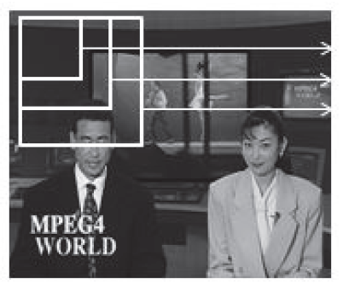
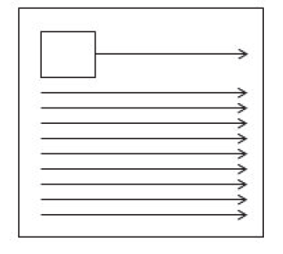
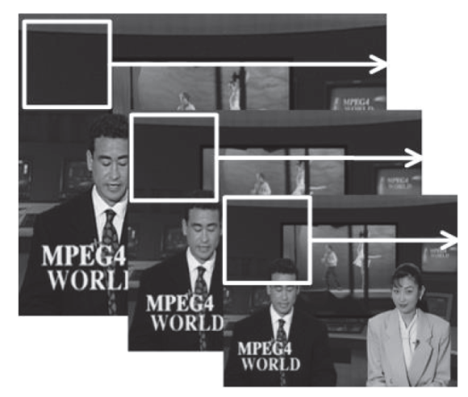
Via-Jones Algorithm
Haar feature
Image Pre-Process
Cascade classifier

Slide 5
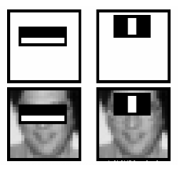
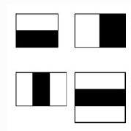
Via-Jones Algorithm
Haar feature
Consists of 2-3 rectangles
OpenCV: 24 x 24 pixels
Image Pre-Process
Cascade classifier

Slide 6
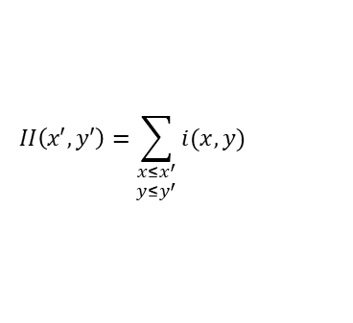


Via-Jones Algorithm
Haar feature
Image Pre-Process
Integral Image
Lighting correction
Cascade classifier
A
B
C
D
$$II\left(x′,y′\right)=\sum_{\begin{aligned}x≤x^{′} \\ y≤y^{′}\end{aligned}}{i(x,y)}$$
$$II\left(x′,y′\right)$$
Sum=A+D-B-C
$$σ=\sqrt{\frac{\sum{{i(x,y)}^{2}}}{N}−μ^{2}}$$
Variance Normalization:

Slide 7
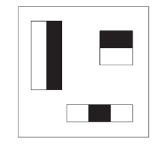
Via-Jones Algorithm
Haar feature
Image Pre-Process
Cascade classifier
Each classifier contains several Haar features
OpenCV: 25 stages & 2913 features
window
pass
…
Stage 1
Stage 2
Stage 25
Face
Not Face
Not Face

Slide 8
Outline
Introduction
HLS design
System evaluation

Slide 9
Integral Image Generator
**Array Partition: complete dim = 1**
B₀ = B₁ -
…
B_{N} = B_{N+1} -
…
II₂₃ = II₂₃+ -
B₂₃ = B₂₃+ -
II_{N} = II_{N} -
New Pixel
**Array Partition: complete dim = 1**
**Array Partition: complete dim = 2**

Slide 10

Variance – Square Sum (II²)
$$σ=\sqrt{\frac{\sum{{i(x,y)}^{2}}}{N}−μ^{2}}$$
Variance Normalization:
**Array Partition: complete dim = 1**
b₀ = b₁ -
b_{N} = b_{N+1} -
…
…
ii₂₃ = ii₂₃+ -
ii_{N} = ii_{N} -
b₂₃ = b₂₃+ -
**Array Partition: complete dim = 1**
(New Pixel)²

Slide 11
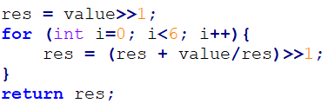
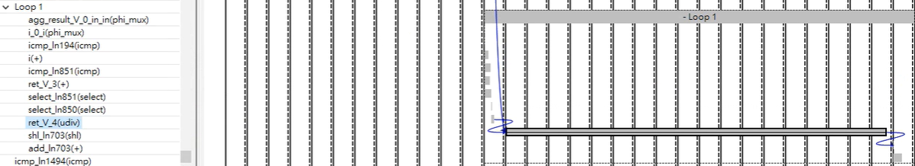
Variance – Square root (√)
$$σ=\sqrt{\frac{\sum{{i(x,y)}^{2}}}{N}−μ^{2}}$$
Variance Normalization:
Original

Slide 12
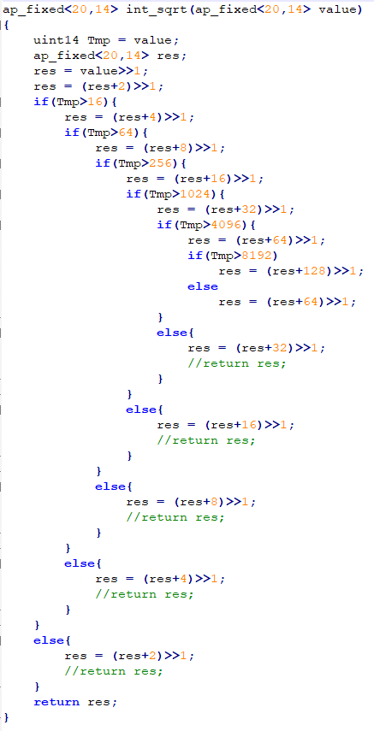
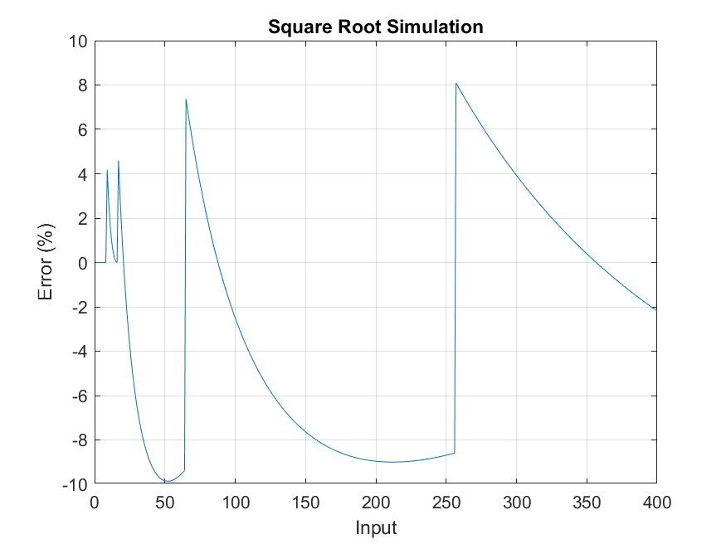
Variance – Square root (√)
New
Latency = 3

Slide 13
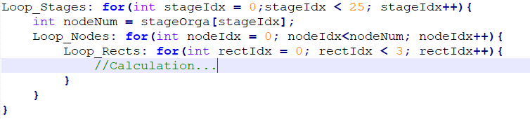
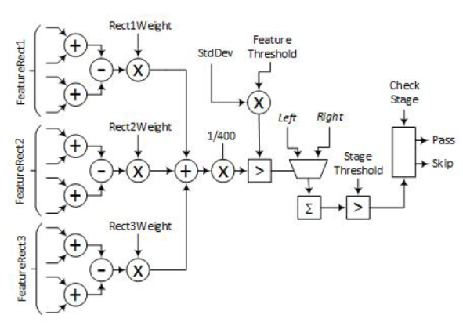
Cascade Classifiers
Nested for loop:
Variable Loop Bound
**Add Pipeline pragma @ Loop_Nodes: unroll inner loop**

Slide 14
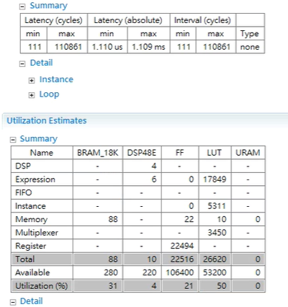
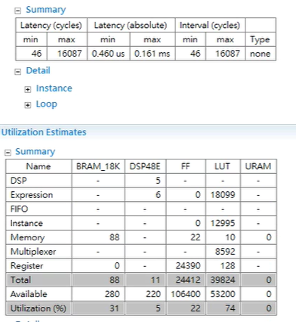
Cascade Classifiers
w/o Pipeline
Pipeline II=3

Slide 15
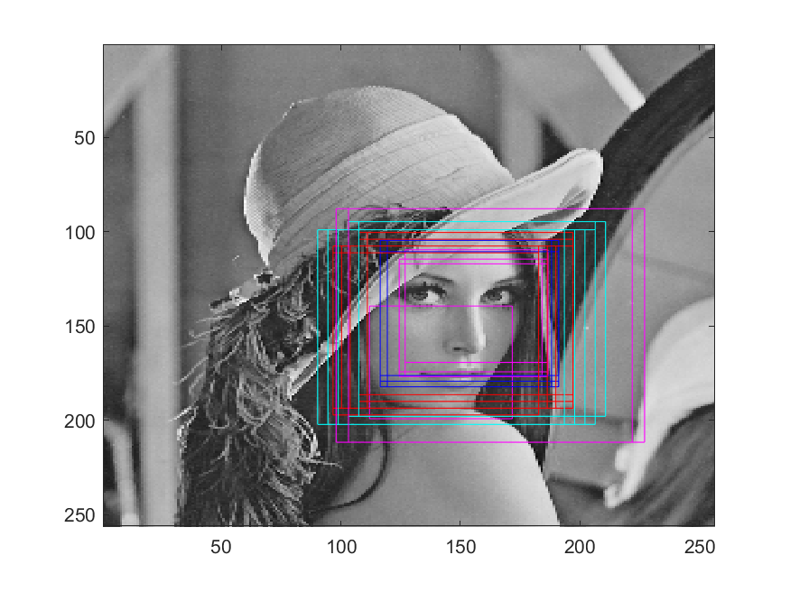
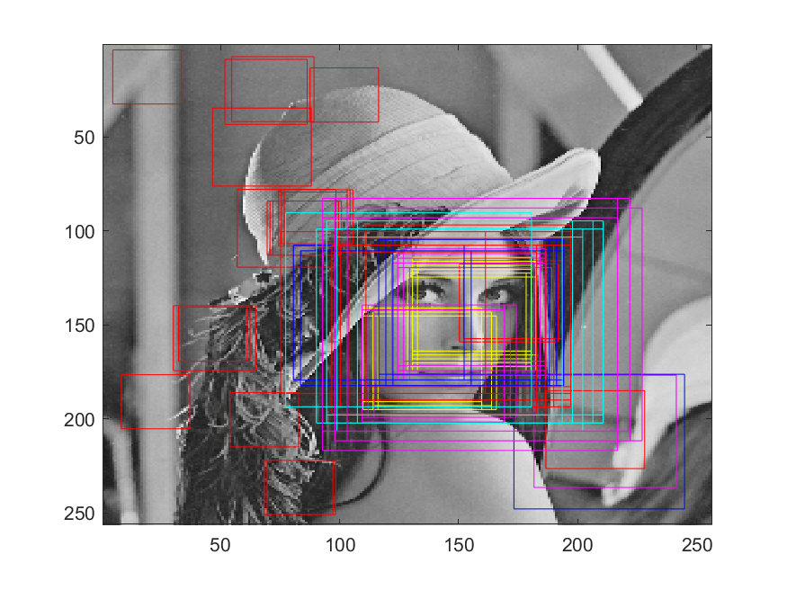
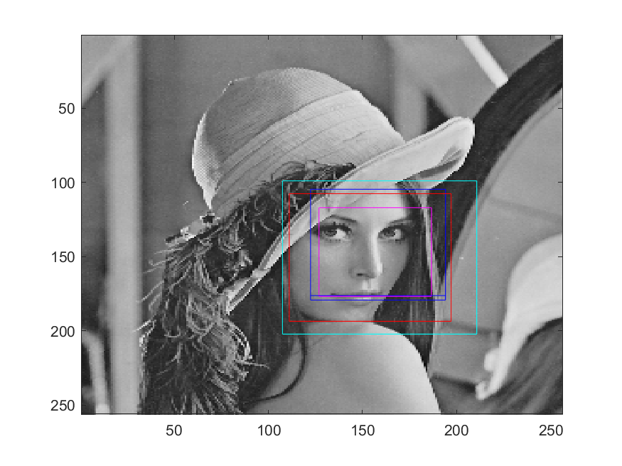
Steal Stages
Use “Lena” as test picture
Remove medium stages
Stronger condition for the output (3 consecutive -> face)
Remove stage 11~22
+ stronger condition
All Stages
Remove stage 11~22

Slide 16
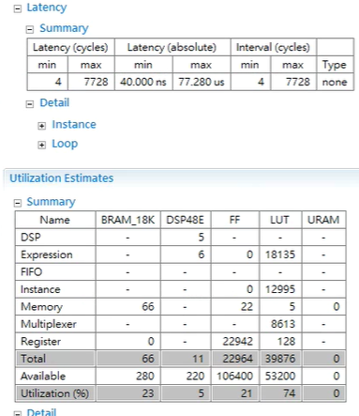
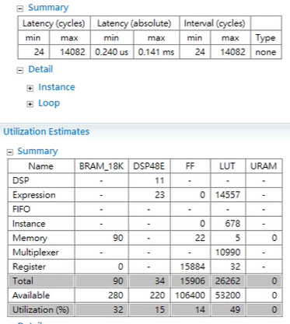
Steal Stages
Pipeline II=3
Pipeline II=6

Slide 17
Short Summary
 | Array Partition | Pipeline | FF | LUT | Latency
Original | N/A | N/A | 3843 | 7743 | 144051
Sol1 | 2D | N/A | 22516 | 26620 | 110861
Sol2 | 2D | 3 | 24412 | 39824 | 16087
Sol3 | 2D | 3 | 22964 | 39876 | 7728
Sol4 | 1D | 6 | 15906 | 26262 | 14082
Steal Stage

Slide 18
Outline
Introduction
HLS design
System evaluation

Slide 19
System Block Diagram
Platform: Zedboard + Pynq
PYNQ
Read Image
Image Resize
Detect
AXIS
IP
Resize End?
No
Yes
AXIlite
AXIS
Result
Detected face?
Yes

Slide 20
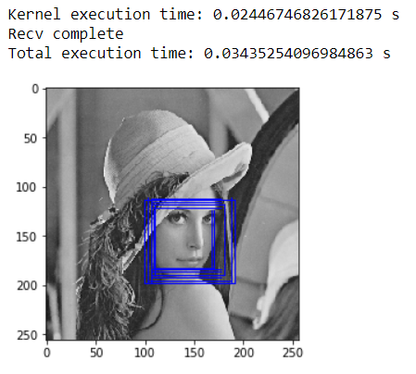
System Result

Slide 21
Reference
Junguk Cho et al. “Fpga-based Face Detection System Using Haar Classiers." In Proceedings of the ACM/SIGDA International Symposium on Field Programmable Gate Arrays. FPGA '09. Monterey, California, USA: ACM, 2009, pp. 103-112.
C. Huang and F. Vahid. “Scalable object detection accelerators on FPGAs using custom design space exploration." In: 2011 IEEE 9th Symposium on Application Specific Processors (SASP). June 2011, pp. 115-121
C. Kumar and M. S. Azam. “A multi-processing architecture for accelerating Haar-based face detection on FPGA." In: 2014 9th International Conference on Industrial and Information Systems (ICIIS). Dec. 2014, pp. 1-5.
HUMAN SAMII MOGHADAM, “Design Exploration of an FPGA Based Face Detection Processing Core Utilizing High Level Synthesis”

Slide 22
Thank you!!!!

